Slide 1
Practice
(sort of...)

Slide 2
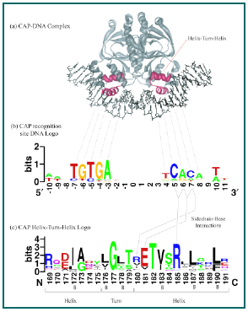
http://weblogo.berkeley.edu/
Graphical representation of an amino acid or nucleic acid multiple sequence alignment developed by Tom Schneider and Mike Stephens

Slide 3
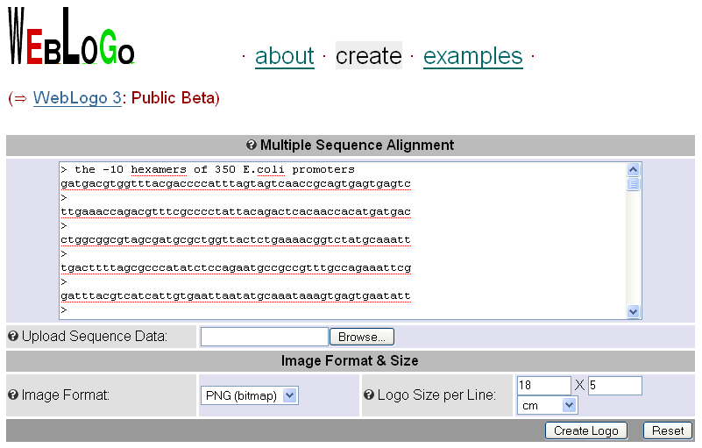
Exercise: Identify conserved motif in the 50 bases upstream of 350 E. coli genes

Slide 4
Results

Slide 5
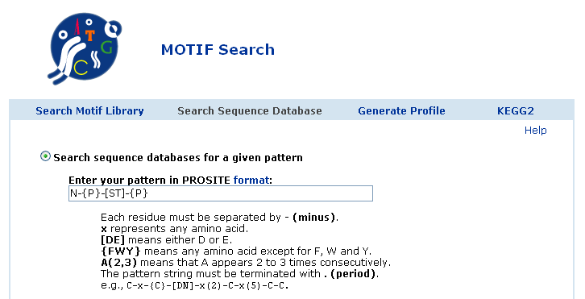
MOTIF Search
http://motif.genome.jp/MOTIF2.html

Slide 6
MOTIF Search
N-linked glycosylation is important for the folding of some of eukaryotic proteins.
Search the N-glycosylation site motif: Asn, followed by anything but Pro, followed by either Ser or Thr, followed by anything but Pro

Slide 7
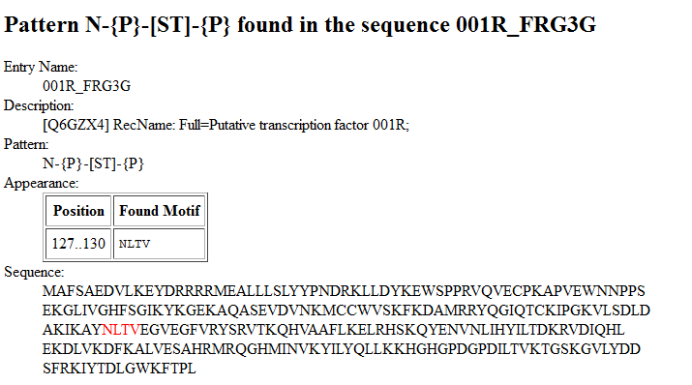
Results

Slide 8
http://www.expasy.ch/prosite/

Slide 9
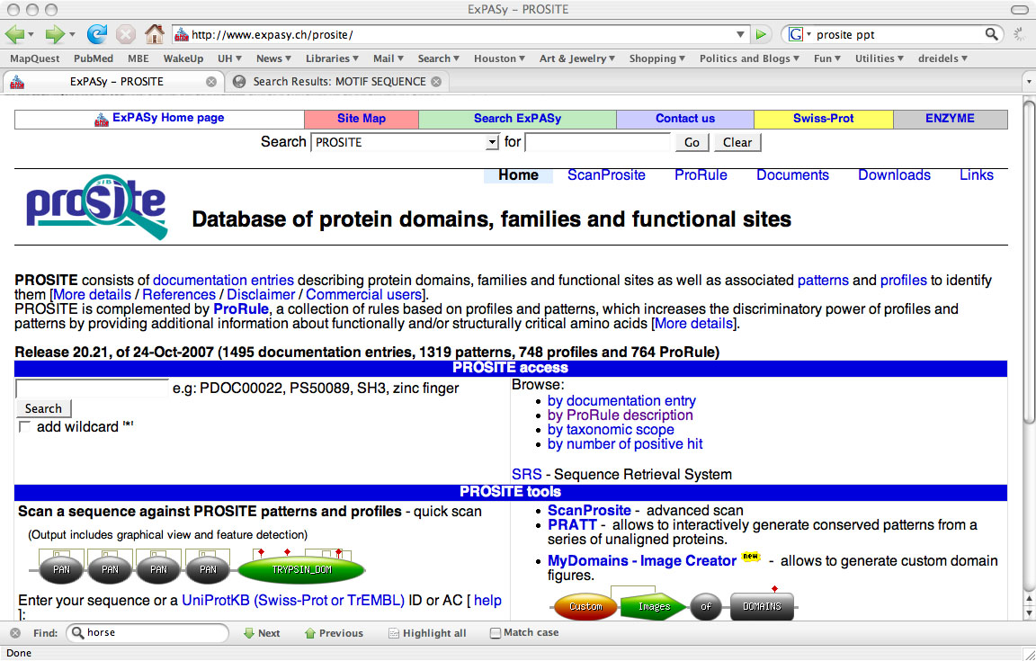

Slide 10
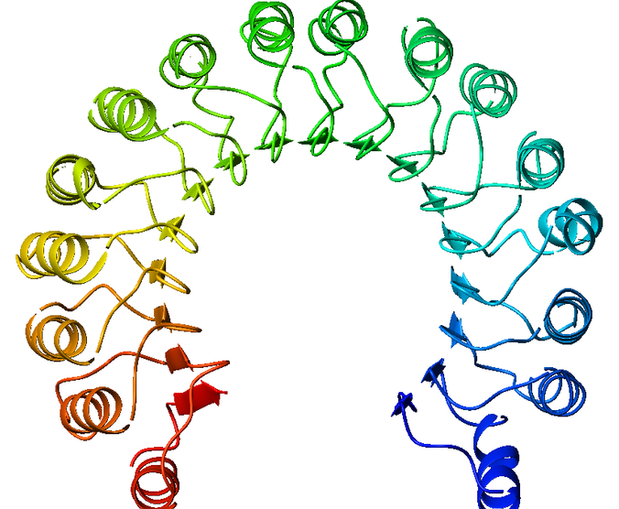
Horseshoe: Leucine-rich repeat

Slide 12
Domain architecture of proteins with Leucine-rich repeats
Alignment of these proteins

Slide 13
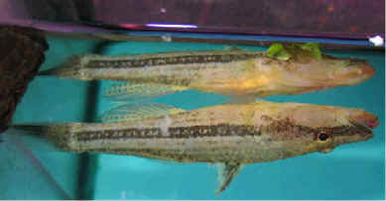
Extract the amino acid sequence of the following protein:
AAW55471
cytochrome oxidase subunit I [Butis butis]
Duckbill sleepers (Butis butis) sometimes swim belly up.

Slide 15
Good luck with the final assignment!

